Slide 1
Neural Networks

Slide 2
Mimics the Parallel interconnections, that exist between the neurons of the brain.
1 op 10^-9: processor vs 10^-3: neuron. Yet neurons are faster for complex tasks such as: Face recognition, natural speech.
Why? The network is massively parallel.

Slide 3
Neural Network: Set of simple, analog signal processors connected by links, where each link has a numeric weight.
It is a directed graph.

Slide 4
O_1
O_2
O_n
Output Layer
Slab or Layer
W_{ij}
Neuron i
I_1
I_2
I_n
Input Layer

Slide 5
Each unit receives stimulation from other units, except the input layer.
The signal received is modulated by the weighting value of the connection.
The modulated in puts are then integrated. (summed)

Slide 6
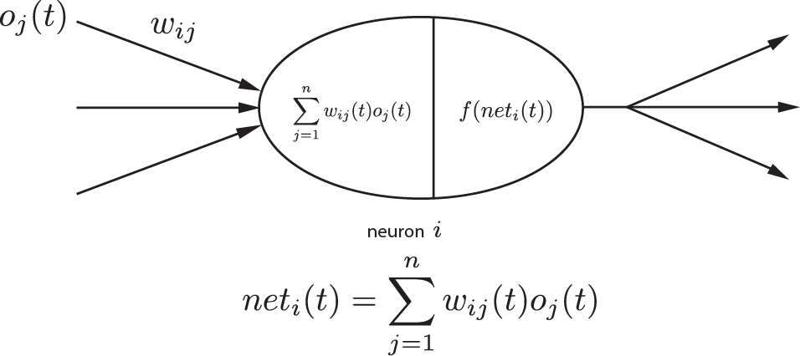
The input is modulated by the weight

Slide 8
Each layer performs an analog integration of it inputs.
From this integration an activation value is determined.

